Slide 1
Object Oriented Programming Design
Presented by
Dr Ramya Devi M
mramyadevi@wilp.bits-pilani.ac.in
CS - 04 : 19th Jul 2025

Slide 2
Classes & Objects

Slide 3
Learning Objectives
Class definition
Object
Exercise in class and object

Slide 4
CLASS and OBJECTS
In Java everything is encapsulated under classes.
Class is the core of Java language.
It can be defined as a template that describe the behaviors and states of a particular entity.
A class defines new data type.
Once defined this new type can be used to create object of that type.
Object is an instance of class.
We call it as physical existence of a logical template class.
In Java, to declare a class the “class” keyword is used.
A class contains both data and methods that operate on that data.

Slide 5
CLASS and OBJECTS
The data or variables defined within a class are called instance variables and the code that operates on this data is known as methods.
Thus, the instance variables and methods are known as class members.
Rules for Java Class
A class can have only public or default access specifier.
It can be either abstract, final or concrete (normal class).
It must have the class keyword, and class must be followed by a legal identifier.
It may optionally extend only one parent class. By default, it extends Object class.
The variables and methods are declared within a set of curly braces.

Slide 6
CLASS and OBJECTS
The syntax for declaring a class is
Access Specifier class className
{
AS data member 1;
AS data member 2;
-------------
-------------
AS return type Method name1(Parameter)
{
Body of the Method
}
AS return type Method name2 (Parameter)
{
Body of the Method

Slide 7
CLASS and OBJECTS
}
-------------
-------------
AS return type Method name n(Parameter)
{
Body of the Method
}
}
Where AS is the access specifier.
If the access specifier is not specified, the corresponding member is considered as default.

Slide 8
Access Specifier
Types of Access Specifier /Modifier
There are four access modifiers in Java and they are:
Modifier | Description
Default | Declarations are visible only within the package i.e. package private (equivalent to friend in C++)
Private | Declarations are visible within the class only
Protected | Declarations are visible within the package or all subclasses
Public | Declarations are visible everywhere

Slide 9
CLASS and OBJECTS
Example for a class
The following is the class for Student
import java.util.*;
class Student
{
String Sname;
int Regno; Data Members
String Dept;
float Percent;
void getInput()
{
Scanner sc=new Scanner(System.in));
Sname=sc.nextLine();

Slide 10
CLASS and OBJECTS
Regno=sc.nextInt();
Dept=sc.nextLine();
Percent=sc.nextFloat();
}
void printOutput()
{
System.out.println(“ Name is “+Sname);
System.out.println(“ Regno is “+Regno);
System.out.println(“ Dept is “+Dept);
System.out.println(“ Percentage is “+Percent);
}
}

Slide 11
Why string inputs after integer input gets skipped in Java?
This is a common problem, and it happens because the nextInt method doesn't read the newline character of your input.
So when you issue the command nextLine, the Scanner finds the newline character and gives you that as a line.
void getInput() {
Scanner sc=new Scanner(System.in);
System.out.println("Enter name");
Sname=sc.nextLine();
System.out.println("Enter Regno");
Regno=sc.nextInt();
sc.nextLine(); //This is for reading the newline after integer
System.out.println("Enter Department");
Dept=sc.nextLine();
System.out.println("Enter Percentage");
Percent=sc.nextFloat();
}

Slide 12
CLASS and OBJECTS
In the above class ,
getInput() and printOutput() are the methods.
Since no access specifier is given for all the data members and methods , all have the default access modifier automatically.
This is how a class looks structurally.
It is a blueprint for an object.
We can call its fields and methods by using the object.
The fields declared inside the class are known as instance variables.
Memory is assigned when an object is created at runtime.
Methods in the class are similar to the functions that are used to perform operations and represent behavior of an object.

Slide 13
Java OBJECTS
Java Object
Object is an instance of a class while class is a blueprint of an object.
An object represents the class and consists of properties and behavior.
Properties refer to the fields declared with in class and behavior represents the methods available in the class.
In real world, we can understand object as a Computer that has its properties like: name, cost, speed etc and behavior like reading, processing etc.
So we can say that object is a real world entity.
Some real world objects are: Man, Mouse, Bike, Car etc.

Slide 14
Creating OBJECTS
The syntax for creating an object is
className variableName = new className (P);
Here,
className is the name of class that can be anything
like: Student that we declared in the above example.
variableName is name of reference variable that is used to hold the reference of created object.
new is a keyword which is used to allocate memory for the object.
P is the list of parameter to be sent to the constructor .
It is optional.
Lets see an example to create an object of class Student that
we created in the above class section.

Slide 15
OBJECTS – Memory allocation
Student S = new Student();
Here,S is an object that represents the class Student during runtime.
The new keyword creates an actual physical copy of the object and assigns it to the variable S.
It will have physical existence and get memory in heap area.
The new operator dynamically allocates memory for an object as.
Sname=null
STACK Regno=0
Dept = null
S Percent = 0.0 f HEAP AREA

Slide 16
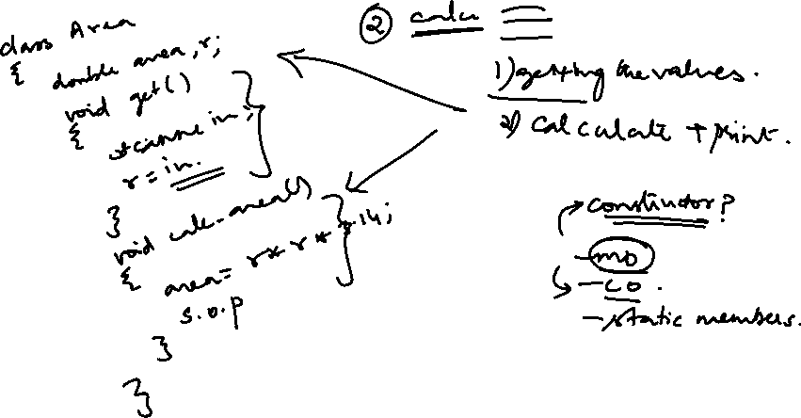
Method Overloading , Constructors, and Static members

Slide 17
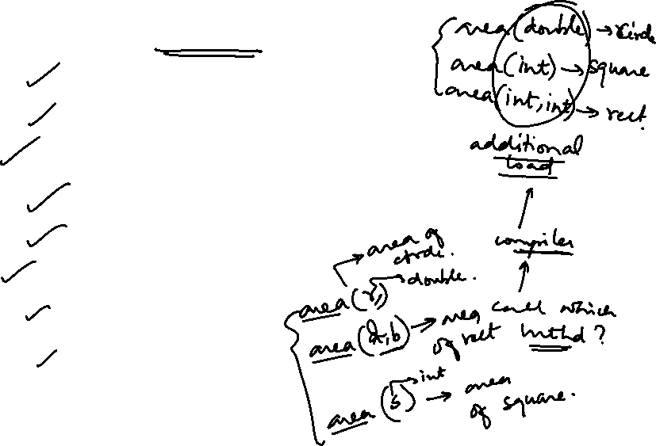
Learning Objectives
Method Overloading
  Rules for overloading methods
  Example for method overloading
Constructors
  Different types of Constructors
  Constructor overloading?
Static members?
  Static data members
  Static methods

Slide 18
METHOD OVERLOADING
Method overloading in Java means multiple methods having the same name but different parameters.
A class can hold several methods having the same name, but different types/order/number of parameters.
Suppose we want to perform the addition of the given numbers.
But user may enter any number of values to add.
The problem without overloading: If we write the method addTwo(int, int) for two parameters, and addThree(int,int,int) for three parameters then it may be difficult for us as well as other programmers to rememberthe names of the methods.
It may be difficult to track how many methods in class that are performing addition because its name differs.

Slide 19
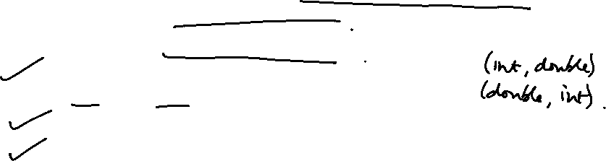
METHOD OVERLOADING - Types
In Java, we can create both the methods with the same name but with different numbers of parameters.
There are three ways to overload the methods:
1. We can overload by changing the number of arguments/parameters.
2. We can overload by changing the data type of arguments.
3. We can overload by changing the Order of the parameters of methods.
1. By changing the number of arguments
We can create multiple methods with the same name, but the number of arguments/parameters should be different.

Slide 20
METHOD OVERLOADING - Types
For Eg.
class MethodOverloading
{
public void show(String name)
{
System.out.println("Name of person = "+name);
}
public void show(String name, String address)
{
System.out.println("Name of person = "+name+ " and Place is = "+
address);
}

Slide 21
METHOD OVERLOADING - Types
public static void main (String [] args)
{
MethodOverloading example = new MethodOverloading();
// If user provides one parameter then thr first method is called
example.show(“Virat Kohli");
// If user provides two parameters then the second method is called
example.show(“Rohit Sharma", “Mumbai");
}
}
Output:
Name of person = Virat Kohli
Name of person = Rohit Sharma and Place is = Mumbai

Slide 22
METHOD OVERLOADING - Types
2. By changing the type of the argument
We can create multiple methods with the same name but the data type of the parameter will be different.
Let’s create two methods with the same name but the parameter type will be different.
class MethodOverloading
{
public void show(String name)
{
System.out.println("Name of person = "+name);
}
public void show(int age)
{
System.out.println("Person age is = "+ age);

Slide 23
METHOD OVERLOADING - Types
}
public static void main (String [] args)
{
MethodOverloading example = new MethodOverloading();
// If user providing parameter of String type then first method is called
example.show(“Sachin");
// If user providing parameter of int type then second method is called
example.show(38);
}
}
The output of the above program:
Name of person = Sachin
Person age is = 38

Slide 24
METHOD OVERLOADING - Types
3. By changing the order of the parameter of methods
We can overload the method by changing the order of parameter. But it is only possible if any method has different types of parameters.
Example:
class MethodOverloading
{
public void show(String name, int age)
{
System.out.println("Name = "+name+ " and age = "+ age);
}

Slide 25
METHOD OVERLOADING - Types
public void show(int age, String name)
{
System.out.println("Name = "+name+ " and age = "+ age);
}
public static void main (String [] args)
{
MethodOverloading example = new
MethodOverloading();
// If user providing parameter of String and int type then first
method called
example.show(“Laxman", 45);
// If user providing parameter of int and String type then
second method called
example.show(25, “Ram");

Slide 26

METHOD OVERLOADING - Types
}
}
Output:
Name = Laxman and age = 45
Name= Ram and age = 25
NOTE: We can’t overload by changing the return type of method

Slide 27
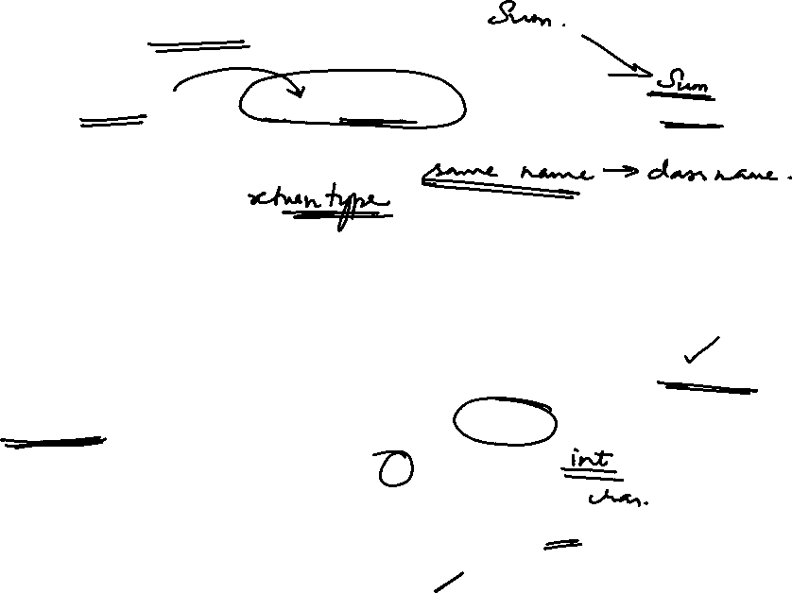
CONSTRUCTORS
CONSTRUCTOR is a special method that is used to initialize newly created object and is called just after the memory is allocated for the object.
It can be used to initialize the objects to desired values or default values at the time of creating the object.
It is not mandatory for the coder to write a constructor for a class.
If no user-defined constructor is provided for a class, compiler
initializes member variables to their default values.
numeric data types are set to 0
char data types are set to null character(‘\0’)
reference variables are set to null

Slide 28
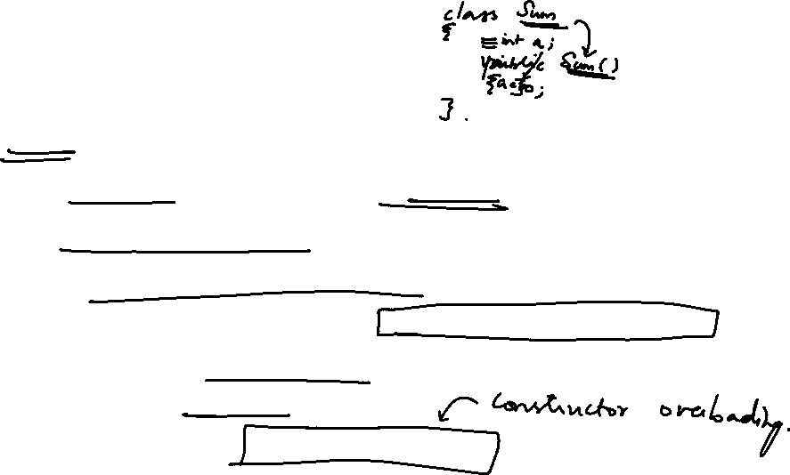
CONSTRUCTORS
Rules for creating a Java Constructor
1. A constructor must have the same name as the class
2. It does not return a value, return type should not be given
3. A constructor may have the parameter(s). If it has at least one parameter, it is called as parameterized constructor
4. If constructor has no parameter, it is called as non parameterized constructor
5. A class may have multiple constructors. If so, it is known as constructor overloading

Slide 29
CONSTRUCTORS - Syntax
The syntax for including a constructor in a class is
class className
{
className ( [parameter(s)])
{
Constructor
Body of the Constructor
}
}
The parameter(s) is optional

Slide 30
CONSTRUCTORS - Example
Example for a Constructor
Class Student
{
String name;
int age;
float avg;
Student( )
{
name=“*******”;
age=20;
avg=50.0f;
}
}

Slide 31
CONSTRUCTORS
When an object is created as,
Student S = new Student();
the data members are initialized with the following values
name=“*******”
age=20
avg=50.0f
S

Slide 32
class Student6
{
int id;
String name;
Student6(int i,String n)
{
id = i;
name = n;
}
Student6(Student6 s)
{
id = s.id;
name =s.name;
}
void display()
{
System.out.println(id+" "+name);
}
public static void main(String args[])
{
Student6 s1 = new Student6(111,"Karan");
Student6 s2 = new Student6(s1);
s1.display();
s2.display();
}
}

Slide 33

Types of Constructor
Types of Constructor
In Java, constructors can be divided into 3 types:
1. No-Arg Constructor/ non parameterized Constructor
2. Parameterized Constructor
3. Default Constructor
1. Java No-Arg Constructors
Similar to methods, a Java constructor may or may not have any parameters (arguments).
If a constructor does not accept any parameters, it is known as a no-argument constructor. For example,

Slide 34
Types of Constructor
Class Student
{
String name;
int age;
float avg; Constructor having no parameter
Student( )
{
name=“*******”;
age=20;
avg=50.0f;
}

Slide 35
Types of Constructor
void display()
{
System.out.prinltn(“ Name “+name+” Age “+age+” AVG ” “+avg);
}
}
class Cons_Demo
{
public static void main(String aa[])
{
Student S = new Student();
S.display();
}
}

Slide 36
Types of Constructor
The output for the above program is
Name ******* Age 20 AVG 50.0
2. Java Parameterized Constructor
Java constructors can also accept one or more parameters.
Such constructors are known as parameterized constructors (constructor with parameters). For example,
class Student
{
String name;
int age;
float avg;

Slide 37
Types of Constructor
Student(String sn,float av )
{
name=sn; Constructor having
age=20; two parameters
avg=av;
}
void display()
{
System.out.prinltn(“ Name “+name+” Age “+age+”
AVG ” “+avg);
}
}

Slide 38
Types of Constructor
class Cons_Demo
{
public static void main(String aa[])
{
Student S = new Student(“NAVEEN”,92.55);
S.display();
}
}
The output for the above program is
Name NAVEEN Age 20 AVG 92.55

Slide 39
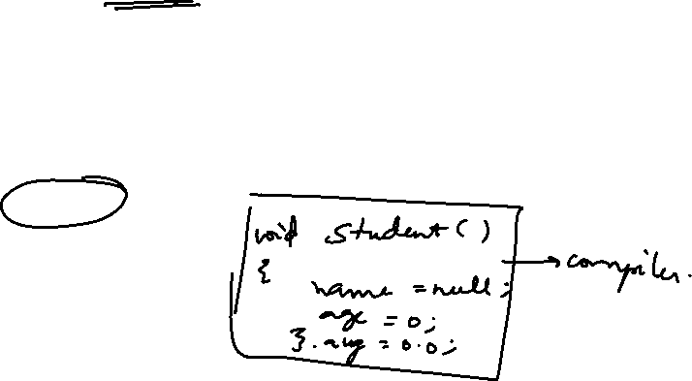
Types of Constructor
3. Java Default Constructor
If we do not include any constructor, the Java compiler automatically creates a no-arg constructor during the execution of the program.
This constructor is called default constructor.
class Student
{
String name;
int age;
float avg; // No Constructor

Slide 40
Types of Constructor
void display()
{
System.out.prinltn(“ Name “+name+” Age “+age+”
AVG ” “+avg);
}
}
class Cons_Demo
{
public static void main(String aa[])
{
Student S = new Student();
S.display();

Slide 41
Types of Constructor
}
}
The output for the above program is
Name NULL Age 0 AVG 0.00f [ Default values are assigned to the data members]
Constructors Overloading in Java
Similar to JAVA method overloading, we can also create two or more constructors with different parameters.
Using different types of constructors is called constructors overloading.

Slide 42
Types of Constructor
Class Student
{
String name;
int age;
float avg;
Student( )
{
name=“*******”; Constructor having
age=20; no parameter
avg=50.0f;
}

Slide 43
Types of Constructor
Student(String sn )
{
name=sn; Constructor having
age=30; one parameter
avg=60.25f;
}
Student(String sn,float av )
{
name=sn; Constructor having
age=21; two parameters
avg=av;
}

Slide 44
Types of Constructor
void display()
{
System.out.prinltn(“ Name “+name+” Age “+age+”
AVG ” “+avg);
}
}
class Cons_Demo
{
public static void main(String aa[])
{
Student S1 = new Student( ); // Execution of non parameterized
Student S2 = new Student(“RAHUL”);
// Execution of parameterized having a single parameter

Slide 45
Types of Constructor
S1.display();
S2.display();
}
}
The output for the above program is
Name ******* Age 20 AVG 50.0
Name RAHUL Age 30 AVG 60.25

Slide 46

Types of Constructor
Copy constructor
Student(Student sn )
{
this.name=sn.name; Constructor having
this.age=sn.age; Object as parameter
this.avg=sn.avg;
}
An object is passed as parameter to the constructor.

Slide 47
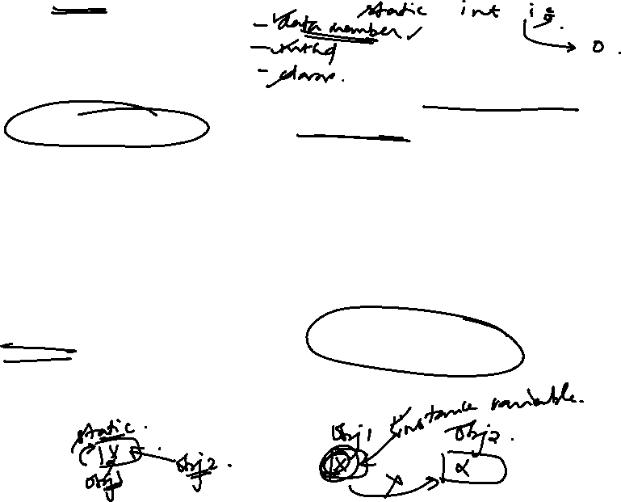
STATIC MEMBERS
Static data member in Java
Static data member in Java is a variable which belongs to the Class and initialized only once at the start of the execution.
It is a variable which belongs to the class and not to any objects (instance) created for the class.
Static variables are initialized only once, at the start of the execution.
These variables will be initialized first, before the initialization of any instance variables.
A single copy will be shared by all instances of the class
A static variable can be accessed directly by the class name and doesn’t need any object

Slide 48
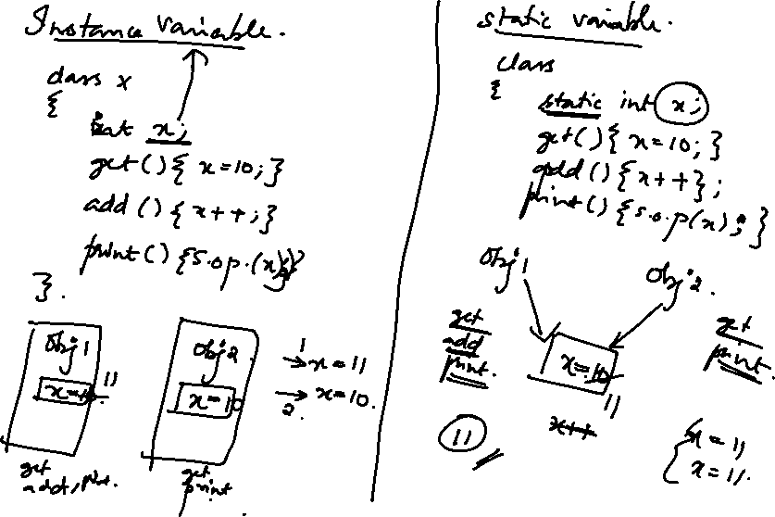

Slide 49
STATIC MEMBERS
To make any data member as static data member, the declaration statement must begin with the keyword “static”.
There will be a single copy of static data member irrespective of number of objects created for the class.
A static data member is also known as non instance data member or class member.
Example:
A class with a static data member is created as follows:
class C
{
int a; non static data members
float b;
static int c; // static data member
}

Slide 50
class A
{
int count;
A()
{
count = count + 1;
}
public static void main(String s[])
{
A obj1 = new A();
A obj2 = new A();
A obj3 = new A();
System.out.println("No. of objects created ="+obj1.count);
System.out.println("No. of objects created ="+obj2.count);
}
}

Slide 51
class A
{
int count;
A()
{
count = count + 1;
}
public static void main(String s[])
{
A obj1 = new A();
A obj2 = new A();
A obj3 = new A();
System.out.println("No. of objects created ="+obj1.count);
System.out.println("No. of objects created ="+obj2.count);
}
}

Slide 52
STATIC MEMBERS
Assume that three objects (instances) are created for the class.
The non static data members (Instance data members / Object data members), a and b are stored in each object created.
So there are three copies of the data members a and b.
But the static data member (Non Instance data member / Class data member) is stored only once outside of all the objects.
Static data member
c = 0
a a a
b b b
Object1 Object 2 Object 3

Slide 53
STATIC MEMBERS
To access the non static data members, we use the syntax
Object reference.data member
To access the static data members, we use the syntax
class name.data member
Static Method in Java
Static method in Java is a method which belongs to the class and not to the object.
A static method can access only static data.
It is a method which belongs to the class and not to the object(instance).
A static method can access only static data.
It cannot access non-static data (instance variables).

Slide 54
STATIC MEMBERS
The rules for using static methods are
1. A static method can call only other static methods and can not call a non-static method.
2. A static method can be accessed directly by the class name and doesn’t need any object
3. A static method cannot refer to "this" or "super" keywords in anyway
To call the static method, we use the syntax
class name.method name (parameter)

Slide 55
STATIC MEMBERS
Example program
class Student {
int a;
static int c=0; //initialized only once to zero
Student()
{
a=10;
c++;
}

Slide 56
STATIC MEMBERS
public void showData()
{
System.out.println("Value of a = "+a);
System.out.println("Value of c = "+c);
}
}

Slide 57
STATIC MEMBERS
public class Demo
{
public static void main(String args[])
{
Student s1 = new Student();
s1.showData();
Student s2 = new Student();
s2.showData();
Student s3 = new Student();
s3.showData();

Slide 58
STATIC MEMBERS
}
}
Expected output is shown below
Value of a = 10
Value of c = 1
Value of a = 10
Value of c = 2
Value of a = 10
Value of c = 3

Slide 59
STATIC MEMBERS
Note 1: If we want to show only the value of c, we can include a static method, showCount() as
static void showCount()
{
System.out.println(“ No: - of Objects “+c);
}
To call this method in the main() method, we don’t require the object reference. It can be called with the class name as
Student.showCount();
Note 2: In the above method, we cannot display the value of ‘a’ because a static method can not access the non static data member.

Slide 60
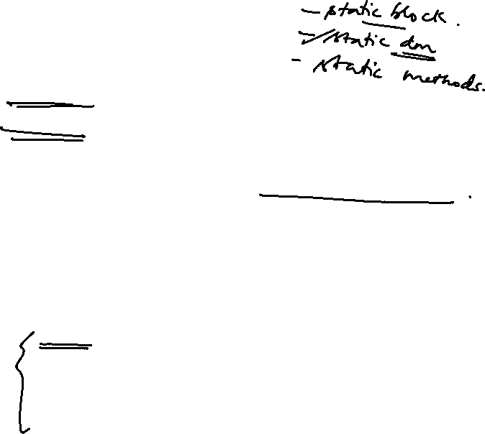
STATIC BLOCK
Static Block in Java
A static block is a block of statement inside a Java class that
will be executed when a class is first loaded into the JVM.
A static block helps to initialize the static data members,
just like constructors help to initialize instance members.
Its syntax is
class class name
{
static
{
Statements for the block
}
}

Slide 61

STATIC BLOCK
Following program is the example of java static block.
public class Demo
{
static int a;
static int b;
static {
a = 10;
b = 20;
}
public static void main(String args[])
{
​

Slide 62

STATIC BLOCK
System.out.println("Value of a = " + a);
System.out.println("Value of b = " + b);
​ }
}
We will get following output of the program.
Value of a = 10
Value of b = 20

Slide 63
Arrays in Java

Slide 64
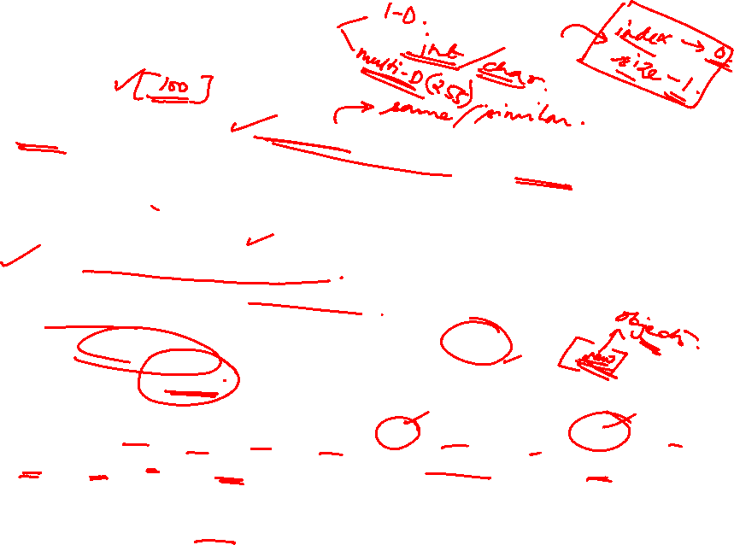
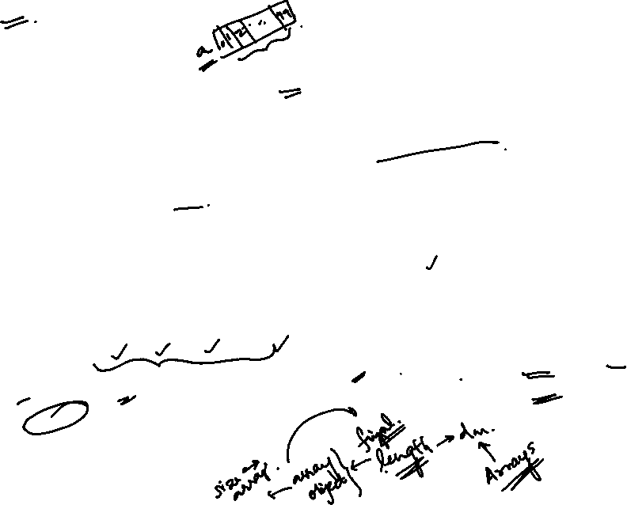
Arrays Introduction
Array → Collection of Homogeneous Data Elements
Arrays are objects and implements only static (fixed-length) arrays
Java follows strict bound checking for referencing array elements. If an attempt is made to reference the elements outside the bounds then “ArrayIndexOutOfBoundsException” will be thrown at run time.
Arrays can
be 1-dimensional (1-D), 2-dimensional (2-D) or
multidimensional.
Maximum Dimensions an Array can have = 255
Arrays are Objects in Java. So, every element at each index is automatically initialized to some default value depending upon the type of array. [byte, short, int and long → 0, float, double → 0.0, booelan → false, char → ‘’ (whitespace) and any class type array → null]
<<length>> is the attribute of each array which can be referenced by
<array-reference-name> . <length>

Slide 65

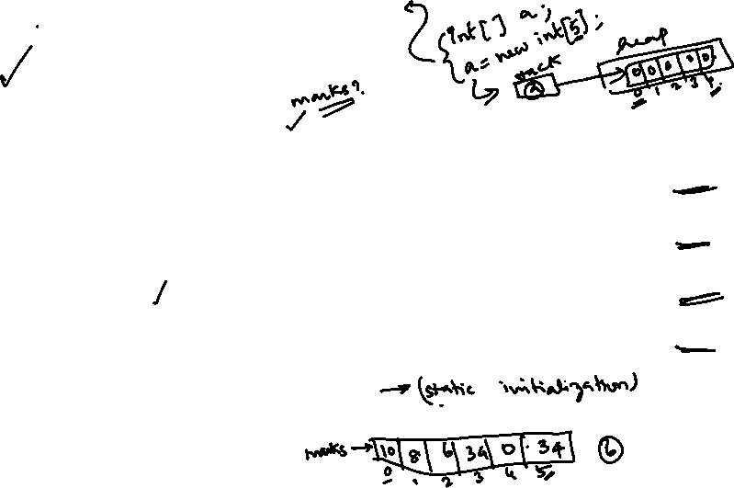
1-dimensional Arrays
Syntax : One-Dimensional Arrays :
type[ ] arrayname = new type[Size];
or
type arrayname[ ] = new type[Size];
Examples :
int[ ] marks = new int[10]; // Each element is initialized to 0
marks is an int type array, marks.length = 10, LB index =0 , UB index = 9
float[ ] values = new float[20]; // Each element is initialized to 0.0
values is an float type array, values.length = 20, LB index =0 , UB index =19
double cgpa[ ] = new double[5]; // Each element is initialized to 0.0
cgpa is double type array, cgpa.length = 5, LB index =0 , UB index = 4
Box[ ] boxes = new Box[20]; // Each element is initialized to ‘null’ value boxes is a Box type array, boxes.length = 20, LB index =0 , UB index = 19
Point points[ ] = new Point[20]; // Each element is initialized to ‘null’ value points is a Point type array, points.length = 20, LB index =0 , UB index =19
6. int[] marks = {10, 8, 6, 34, 0, 34};
marks is a int type array, marks.length = 6, LB index = 0, UB index = 5

Slide 66
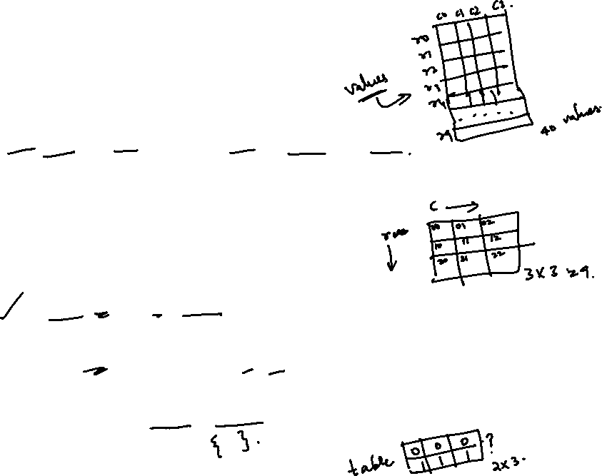
2-dimensional Arrays
Syntax : Two-Dimensional Arrays :
type[ ][ ] arrayname = new type[Row_Size][Col_Size];
or
type arrayname[ ][ ] = new type[Row_Size][Col_Size]; Row index varies from 0 to Row_Size – 1
Column index varies from 0 to Col_Size – 1
Examples :
int[ ][ ] data = new int[3][3]; // Each element is initialized to 0
data is 2-D int array, capacity = 9, row index 0 to 2 col index 0 to 2
float values[][] = new float[10][4]; // Each element is initialized to 0.0
values is 2-D float array, capacity = 40, row index 0 to 9 col index 0 to 3
int table[][] = {{ 0,0,0},{1,1,1}}; // initializes first row to 0 & second to 1

Slide 67
2-dimensional Arrays ….
Java treats a 2-D array as a collection of 1-D arrays.
In two-dimensional arrays, individual rows can have variable number of elements <Variable Size Array>
Example
int[][] data = new int[4][]; // Variable-Size Array, column-size not mentioned data is a 2-D array having 4 rows (row-index varies from 0 to 3)
data[0] = new int[10]; data[1] = new int[5]; data[2] = new int[6]; data[3] = new int[10];
// Row-0 has 10 elements, column-index varies from 0 to 9
// Row-1 has 5 elements, column-index varies from 0 to 4
// Row-2 has 6 elements, column-index varies from 0 to 5
// Row-3 has 10 elements, column-index varies from 0 to 9
data[1][6] →
data[2][6] →
Results in ArrayIndexOutofBounds Exception
Results in ArrayIndexOutofBounds Exception

Slide 68
Referring Array Elements
1-D Arrays, Syntax → array-name[<index>], where <index>
varies from 0 (LB) to array-name.length-1(UB)
2-D Arrays, Syntax → array-name[<row-index>][<col-index], where <row-index> varies from 0 to no-of-rows -1, and <col- index> varies from 0 to no-of-cols -1.
Example
int[] data = new int[5] ;
boolean[] flags = new boolean[10];
String[] names = new String[5];
double[]
data[0] = 0; ….., data[4] = 0; flag[0] = false, ….., flags[9] = false
names[0]=null, …..., names[4] = null
values = {10.5, 5.6, 7.5, 4.5};
values[0] = 10.5, values[1] = 5.6, values[2] = 7.5, values[3] = 4.5
5. int [][] marks = {{10,40,20},{25,56,57},{10,89,94}}
marks[0][0] = 10, marks[0][1] = 40, marks[0][2] = 20,
marks[1][0] = 25, marks[1][1] = 56, marks[1][2] = 57,
marks[2][0] = 10, marks[2][1] = 89, marks[2][2] = 94

Slide 69
Displaying 1-D Array Elements
Two Methods
  Method 1: Using for { .. } loop Example :
int data[] = {10,6,8,9,-4,5};
for(int i=0; i<data.length; i++)
Variable automatically considered
is
as of
‘int’ type The same
System.out.println(data[i]); ^{variable}
is to be
used inside the loop
Method 2: Using for each loop
Syntax : for(<type-of-array> <variable> : <array-name>) Example :
int data[] = {10,6,8,9,-4,5};
for(int i : data)
System.out.println(i);

Slide 70
Displaying 1-D Array Elements
: Example 1
// File Name : Demo.java class Demo
{
public static
{
boolean[]
<<OUTPUT>>
void
main(String[] args)
flags = new boolean[5];
Output by Method 1 false
false false false false
Output by Method 2 false
false false false false
// Method-1 : Using for loop System.out.println(“Output by Method 1”); for(int i =0; i < flags.length; i++)
System.out.println(flags[i]);
// Method-2 : Using for each loop System.out.println(“Output by Method 2”); for(boolean k : flags)
System.out.println(k);
}// End of Method
}// End of class Demo
9

Slide 71
Displaying 1-D Array Elements
: Example 2
// File Name : Demo.java class Demo
{
public static
{
void main(String[] args)
names = new String[5];
F:\>java Demo Output by Method 1 null
null null null null
Output by Method 2 null
null null null null
String[]
// Method-1 : Using for loop System.out.println("Output by Method 1"); for(int i =0; i < names.length; i++)
System.out.println(names[i]);
// Method-2 : Using for each loop System.out.println("Output by Method 2"); for(String k : names)
System.out.println(k);
}// End of Method
}// End of class Demo

Slide 72
Displaying 2-D Array Elements
Two Methods
  Method 1: Using nested for { .. } loop Example :
int data[][] = new int[5][5]; System.out.println(data.length); for(int i=0; i<data.length; i++)
for(int j=0; j<data[i].length; j++)
// Displays 5 not 25
// data.length = no of rows
// each jth column under ith row
System.out.println(data[i][j]);
Method 2: Using nested for each loop
Syntax :
for(<type-of-array> [ ] <variable-i> : <array-name>) for(<type-of-array> <variable-j> : <variable-i>

Slide 73
Displaying 2-D Array Elements
: Example
// File Name : Demo.java
class Demo
{
public
{
static void main(String[] args)
int[][] data = new int[5][5];
System.out.println(data.length); // Displays 5
// Method 1
System.out.println("Method 1 : Using Nested for Loop"); for(int i = 0; i < data.length; i++)
for(int j = 0; j < data[i].length; j++)
System.out.println(data[i][j]);
// Method 2
System.out.println("Method 2 : Using Nested for-each Loop"); for(int[] i : data)
for(int j : i)
System.out.println(j);
}// End of Method
}// End of class Demo

Slide 74

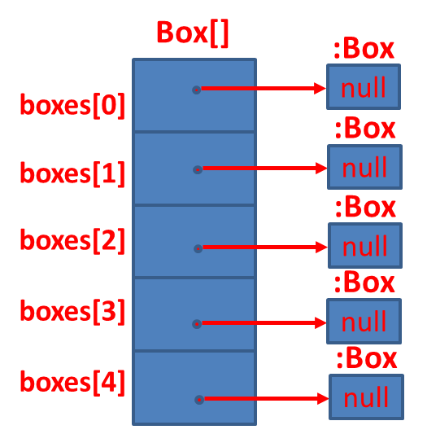
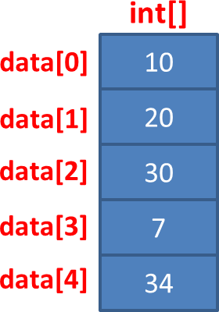
Primitive Type vs Object Type Array
int[] data = { 10, 20, 30, 7, 34 };
Box[] boxes = new
Box[5];
String[] names = { “David”, “Ram”, “Mike”};
String[] :String
names[0]
David
:String
names[1]
Ram
:String
names[2]
Mike

Slide 75
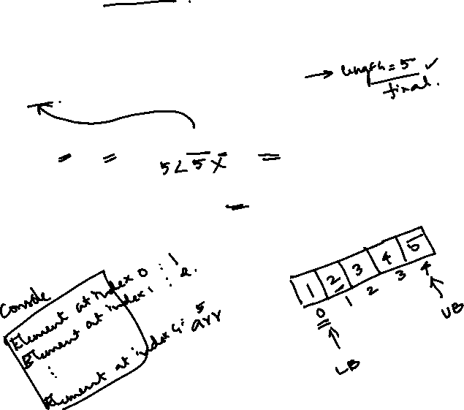
public class ArrayExample {
public static void main(String[] args) {
int[] arr = {1, 2, 3, 4, 5};
for (int i = 0; i < arr.length; i++) {
System.out.println("Element at index " + i + ": " + arr[i]);
}
}
}

Slide 76
public class SumOfArray {
public static void main(String[] args) {
int[] arr = {10, 20, 30, 40, 50};
int sum = 0;
for (int i = 0; i < arr.length; i++) {
sum += arr[i];
}
System.out.println("Sum of elements: " + sum);
}
}

Slide 77
public class MaxElement {
public static void main(String[] args) {
int[] arr = {5, 8, 12, 7, 3};
int max = arr[0];
for (int i = 1; i < arr.length; i++) {
if (arr[i] > max) {
max = arr[i];
}
}
System.out.println("Maximum element: " + max);
}
}

Slide 78
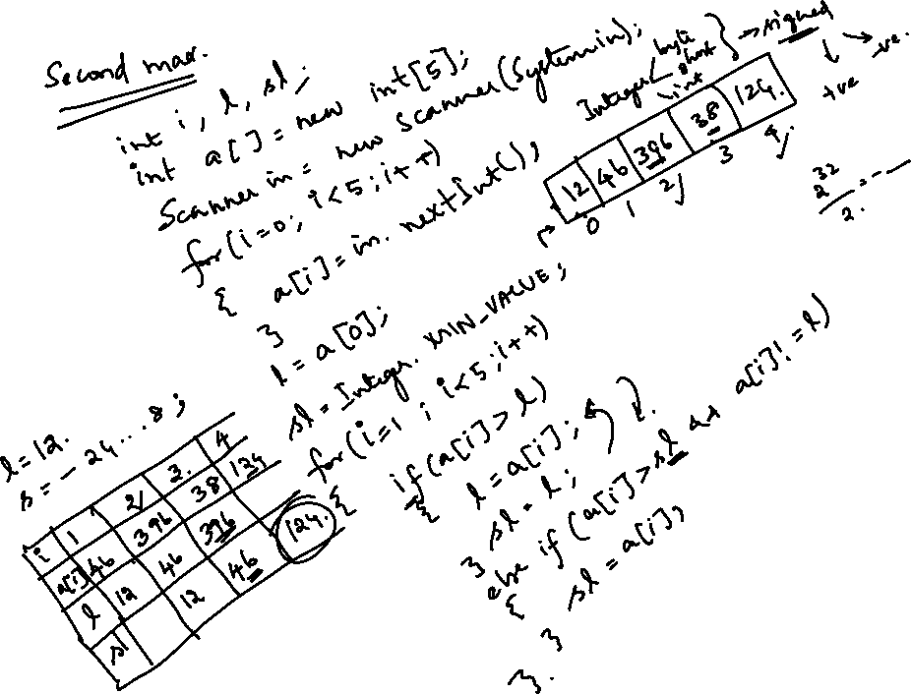

Slide 79
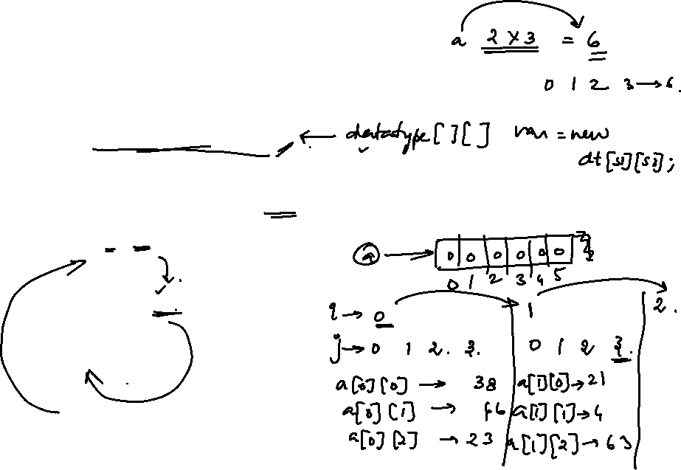
import java.util.*;
public class ArrayExample {
public static void main(String[] args) {
Scanner in = new Scanner(System.in);
int a[][] = new int[2][3];
int i,j;
System.out.println("Enter array elements: ");
for(i=0;i<2;i++)
{
for(j=0;j<3;j++)
{
a[i][j] = in.nextInt();
}
}

Slide 80
System.out.println("Enter array elements: ");
for(i=0;i<2;i++)
{
for(j=0;j<3;j++)
{
System.out.print(a[i]+" ");
}
System.out.println();
}
}
}

Slide 81
Arrays Class in Java

Slide 82

Arrays class in Java
Arrays class in <<java.util>> package is defined as
follows
This class contains the required methods for manipulating arrays such as sorting and searching
All methods are <<static>> and hence can be called via class name.
Arrays class is part of Java’s Collection Framework

Slide 83

Arrays class: Important Methods
binarySearch()
static int | binarySearch(byte[] a, byte key)
static int | binarySearch(char[] a, char key)
static int | binarySearch(double[] a, double key)
static int | binarySearch(float[] a, float key)
static int | binarySearch(int[] a, int key)
static int | binarySearch(long[] a, long key)
static int | binarySearch(Object[] a, Object key)
static int | binarySearch(Object[] a, Object key, Comparator c)
static int | binarySearch(short[] a, short key)

Slide 84

Arrays class: Important Methods ….
equals()
static boolean | equals(boolean[] a, boolean[] a2)
static boolean | equals(byte[] a, byte[] a2)
static boolean | equals(char[] a, char[] a2)
static boolean | equals(double[] a, double[] a2)
static boolean | equals(float[] a, float[] a2)
static boolean | equals(int[] a, int[] a2)
static boolean | equals(long[] a, long[] a2)
static boolean | equals(Object[] a, Object[] a2)
static boolean | equals(short[] a, short[] a2)

Slide 85
Arrays class: Important Methods ….
fill()
static void | fill(boolean[] a, boolean val)
static void | fill(boolean[] a, int fromIndex, int toIndex,
 | boolean val)
static void | fill(byte[] a, byte val)
static void | fill(byte[] a, int fromIndex, int toIndex, byte val)
static void | fill(char[] a, char val)
static void | fill(char[] a, int fromIndex, int toIndex,
 | char val)
static void | fill(double[] a, double val)
static void | fill(double[] a, int fromIndex, int toIndex,
 | double val)
static void | fill(float[] a, float val)

Slide 86
Arrays class: Important Methods ….
fill() ….
static void | fill(float[] a, int fromIndex, int toIndex, float val)
static void | fill(int[] a, int val)
static void | fill(int[] a, int fromIndex, int toIndex, int val)
static void | fill(long[] a, int fromIndex, int toIndex,
 | long val)
static void | fill(long[] a, long val)
static void | fill(Object[] a, int fromIndex, int toIndex,
 | Object val)
static void | fill(Object[] a, Object val)
static void | fill(short[] a, int fromIndex, int toIndex,
 | short val)
static void | fill(short[] a, short val)

Slide 87
Arrays class: Important Methods ….
sort()
static void | sort(byte[] a)
static void | sort(byte[] a, int fromIndex, int toIndex)
static void | sort(char[] a)
static void | sort(char[] a, int fromIndex, int toIndex)
static void | sort(double[] a)
static void | sort(double[] a, int fromIndex, int toIndex)
static void | sort(float[] a)
static void | sort(float[] a, int fromIndex, int toIndex)
static void | sort(int[] a)
static void | sort(int[] a, int fromIndex, int toIndex)

Slide 88
Arrays class: Important Methods ….
sort()….
static void | sort(long[] a)
static void | sort(long[] a, int fromIndex, int toIndex)
static void | sort(Object[] a)
static void | sort(Object[] a, Comparator c)
static void | sort(Object[] a, int fromIndex, int toIndex)
static void | sort(Object[] a, int fromIndex, int toIndex, Comparator c)
static void | sort(short[] a)
static void | sort(short[] a, int fromIndex, int toIndex)

Slide 89
Arrays class: Example
import java.util.*; class ArrayExample
{
Import java.util package to use
Arrays class
public static void main(String args[])
{
int x[] = {10,6,8,20};
int array Size = 4 LB=0 UB =3
double data[]
= { 12.5,34.6,90.56,12.34,12.56};
double array Size = 5 LB=0 UB =4
float values[] = { 10.45f,23.56f,12.67f};
float arrays Size = 3 LB=0 UB =2
double data1[] = new double[10];
double array Size = 10 LB=0
UB =9
boolean flags[] = new boolean[5];
boolean array Size = 5 LB=0 UB =4
int x1[] = {10,6,8,20};
int array Size = 4 LB=0 UB =3

Slide 90
Arrays class: Example ….
System.out.println(Arrays.binarySearch(x,20));
Arrays.sort(x);
Prints index of 20 in x
Sorts elements of x
Prints Elements of x
3
for(int i=0;i<x.length;i++) System.out.print(x[i]+" "); System.out.println();
Arrays.fill(data1,12.56);
6 8 10 20
Fills a single value
12.56 in all indexes of
data1
for(int i=0;i<data1.length;i++) System.out.print(data1[i]+" "); System.out.println();
Prints Elements of data1
12.56 12.56 12.56 12.56 12.56 12.56 12.56 12.56 12.56 12.56

Slide 91
Arrays class: Example ….
Arrays.fill(flags,2,5,true);
//Arrays.fill(flags,2,6,true); for(int i=0;i<flags.length;i++) System.out.print(flags[i]+" "); System.out.println();
System.out.println(Arrays.equals(x,x1));
Arrays.sort(values);
for(int i=0;i<values.length;i++) System.out.print(values[i]+" "); System.out.println();
}
} // End of class
Fills true value in boolean array flags from index 2 to 4
ArrayIndexOutofBoundsException
false false true true true
Prints true or false whether x
and x1 equals
Sorts the elements of arrays
10.45 12.67 23.56

Slide 92
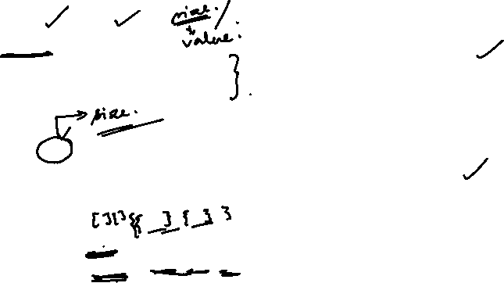
Array : Examples
10
8
6
int a[] = { 10,8,6};
for(int i=0;i<a.length;i++) System.out.println(a[i]);
']' expected
int a[3] = { 10,8,6};
^
1 error
int a[3] = { 10,8,6};
for(int i=0;i<a.length;i++)
System.out.println(a[i]);
//int table[][]={0,0,0,1,1,1};
//int table[2][3]={0,0,0,1,1,1};
WRONG
int table[ ][ ]={{0,0,0},{1,1,1}};
for(int i=0; i<table.length;i++)
{
for(int j=0;j<table[i].length;j++)
{
System.out.print(table[i][j]);} System.out.println();
000
111
}

Slide 93
Thanks

